Slide 1

Bachelor Thesis: Automatic Optimization in DaCe using Machine Learning
Benedikt Schesch

Slide 2
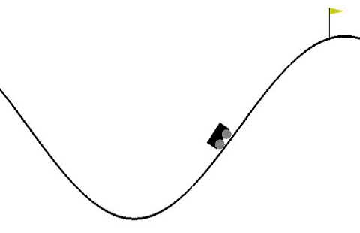
Introductory Tasks
DaCe Tutorials &Papers
Solving the mountain car problem using the PPO Algorithm

Slide 3
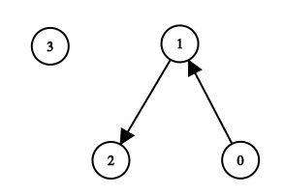
Reachability using a GNN
Using a Message Passing Neural Network in PTGNN to solve the reachability problem in a graph
0
0
0
1
0
1
1
1
Key takeaway:
- The number of iterations is extremely important
Accuracy: 99.99%

Slide 4
Predicting Vectorization
Predict if a set of input Memlets, output Memlets and a Map Entry are Vectorizable
Input Memlets
Memlet
GRU
Output Memlets
Neural
Network
Vectorizable?
Map Entry
GRU
Map Entry
Training accuracy: 98.26%
Validation accuracy: 98.36%

Slide 5
Normalization

Slide 6
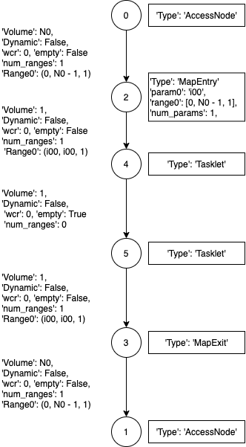
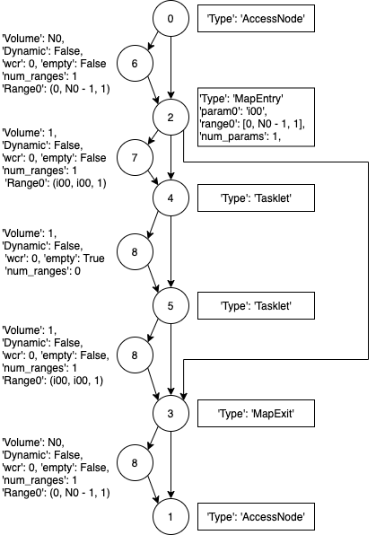
Memlets to nodes

Slide 7
Predicting Vectorization in the SDFG
Use a Graph Neural Network in PTGNN over the SDFG to predict if vectorization can be applied on all the tasklets
Reuse the previous Embedding
Training accuracy:99.68%
Validation accuracy:97.90%

Slide 8
Next Steps
Predict more complex Transformations
The model does not manage to learn Map Fusion for now
Start with the Reinforcement Learning part of the problem

